Slide 1
Hand Gesture Recognition
Group Name: TheWildcards
- Akash Soni
- Kashish Shah
- Raj Shah
School of Engineering & Applied Science||AHMEDABAD UNIVERSITY

Slide 2
Motivation
Among us, there are some people who do not have the voice to express, and sometimes, the capability to hear.
The deaf and dumb sign language was developed to aid the communication for such people.
Our idea is to create a user-friendly interface which could help them communicate, to give them a voice.

Slide 3
Problem Statement
The problem statement consists of two parts:
Hand Recognition System
Hand Gesture Recognition System
Region of Interest: Palm

Slide 4
Existing Literature
"Hand-gesture recognition using computer-vision techniques", 2013, David J. Rios-Soria, Satu E. Schaeffer, Sara E. Garza-Villarreal, Universidad Autónoma de Nuevo León (UANL) San Nicolás de los Garza, NL, Mexico. (21st International Conference on Computer Graphics, Visualization and Computer Vision 2013)
“HAND GESTURE RECOGNITION: A LITERATURE REVIEW”, Rafiqul Zaman, Khanand Noor, Adnan Ibraheem, 2012, Department of Computer Science, A.M.U. Aligarh, India. (International Journal of Innovative Research in Computer and Communication Engineering )

Slide 5
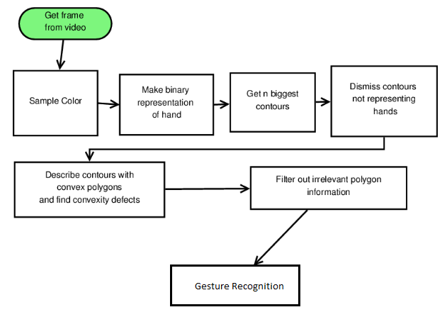
Flowchart Representation

Slide 6
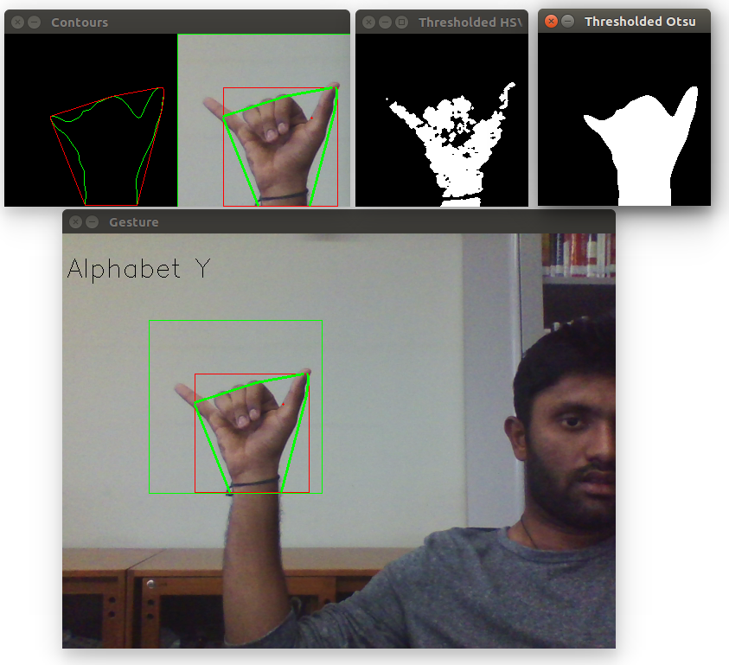
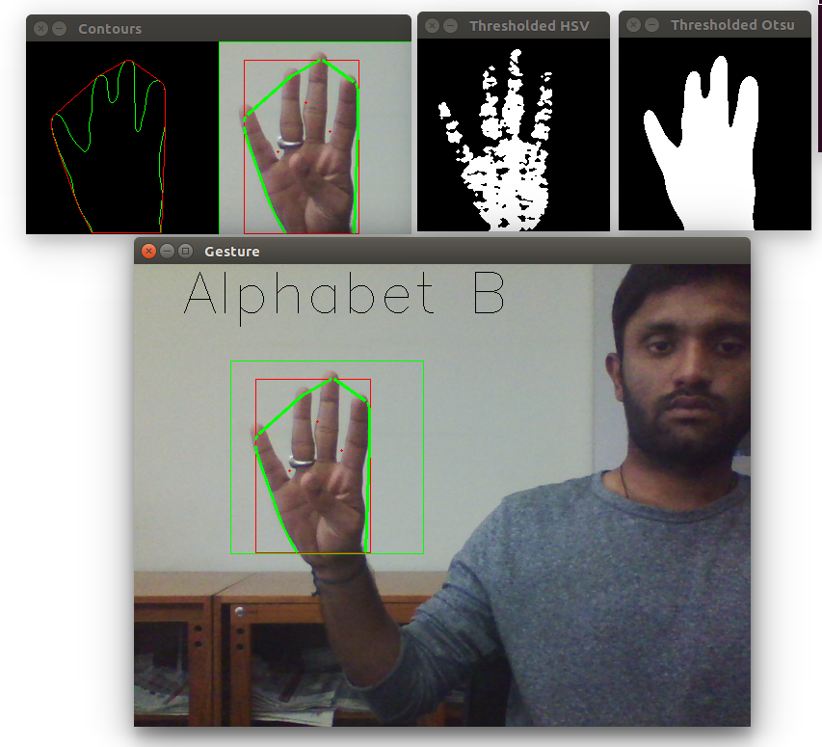
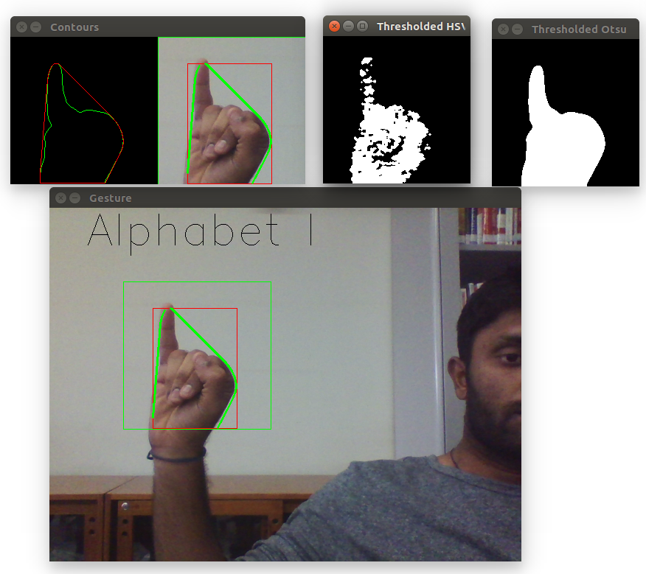
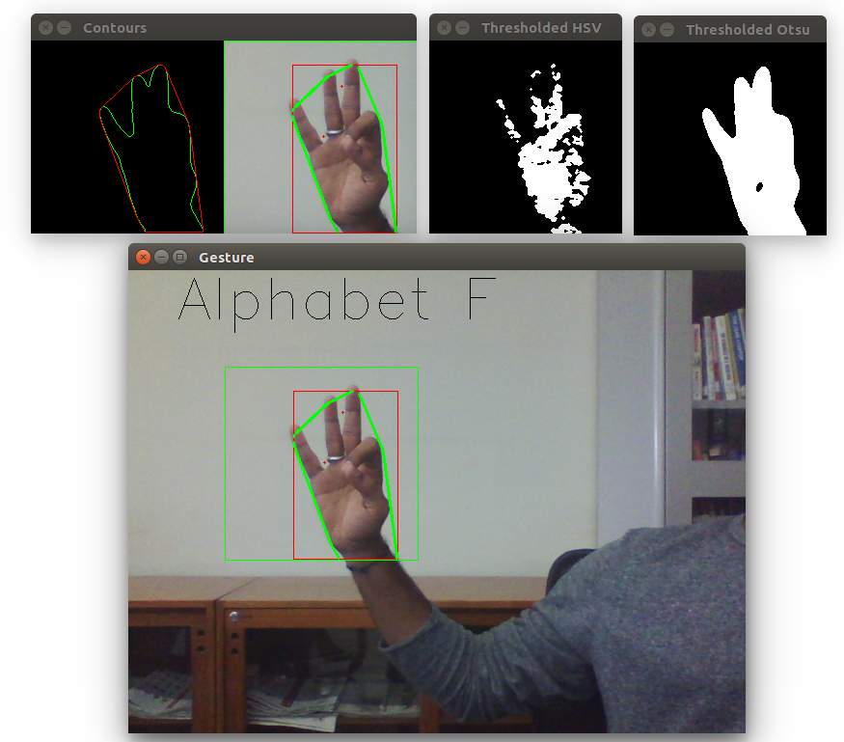
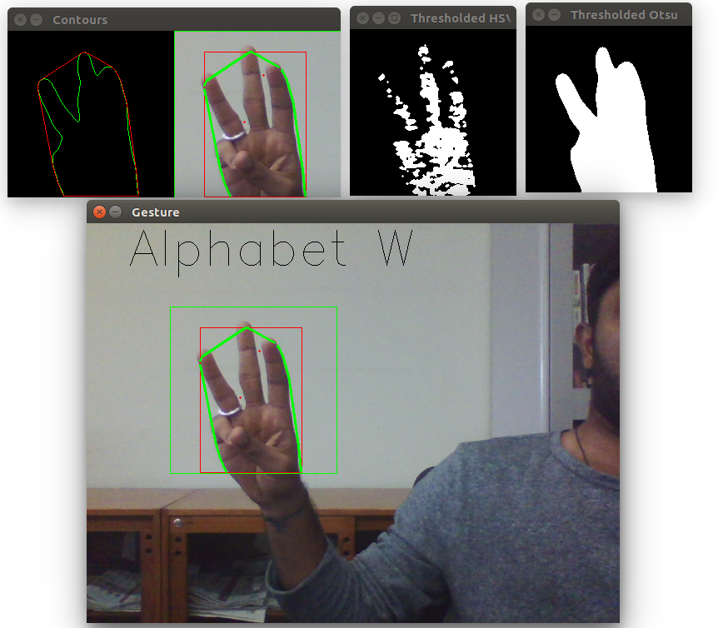
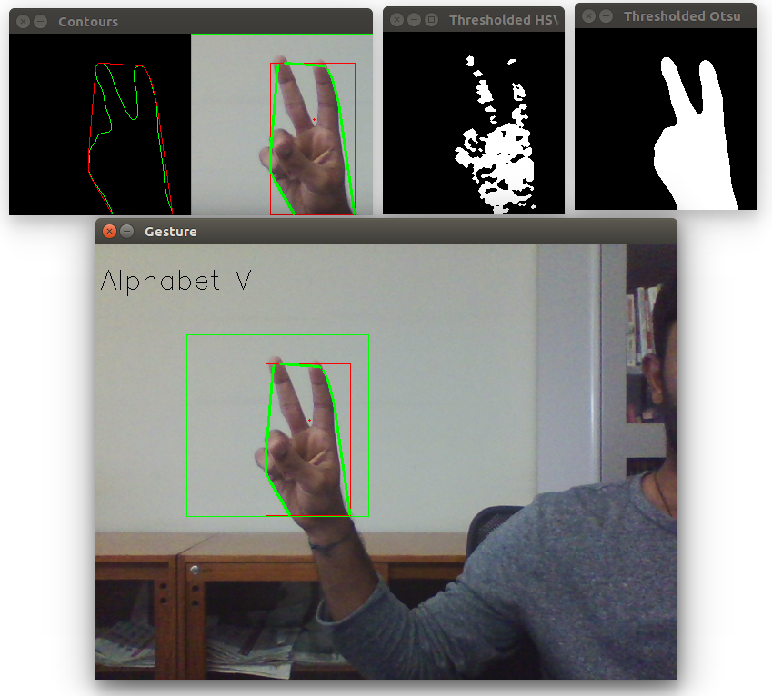
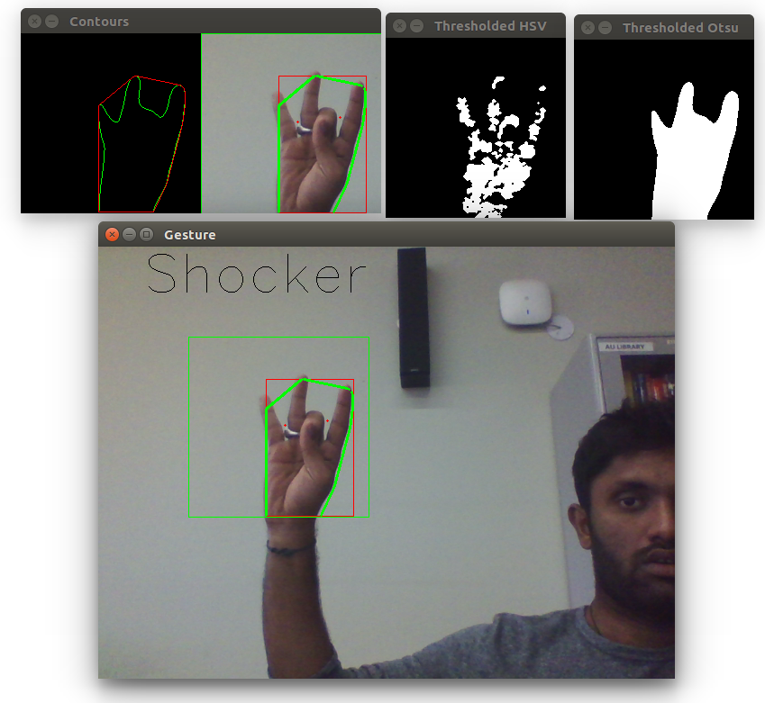
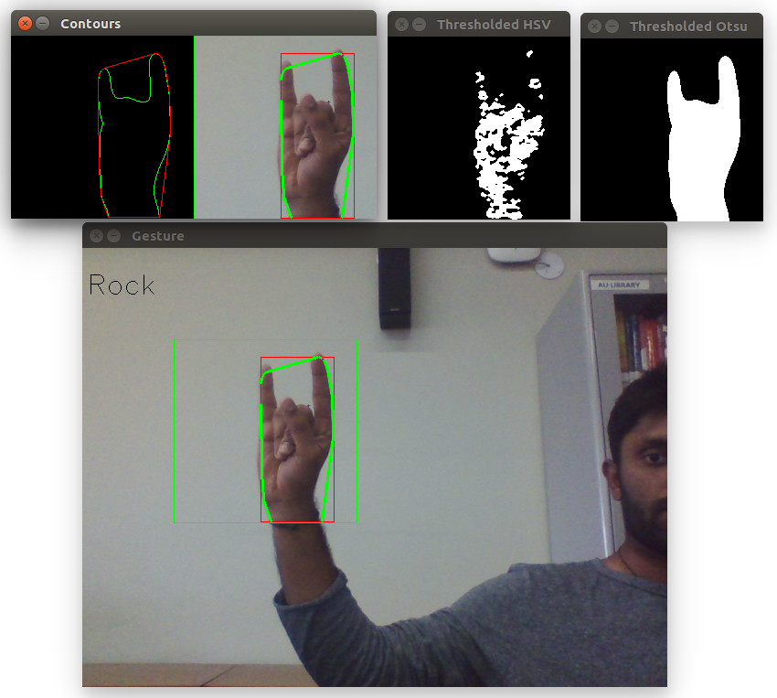
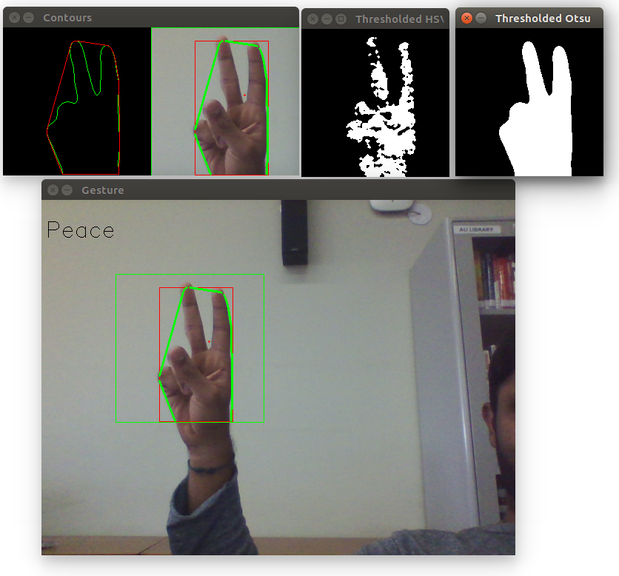
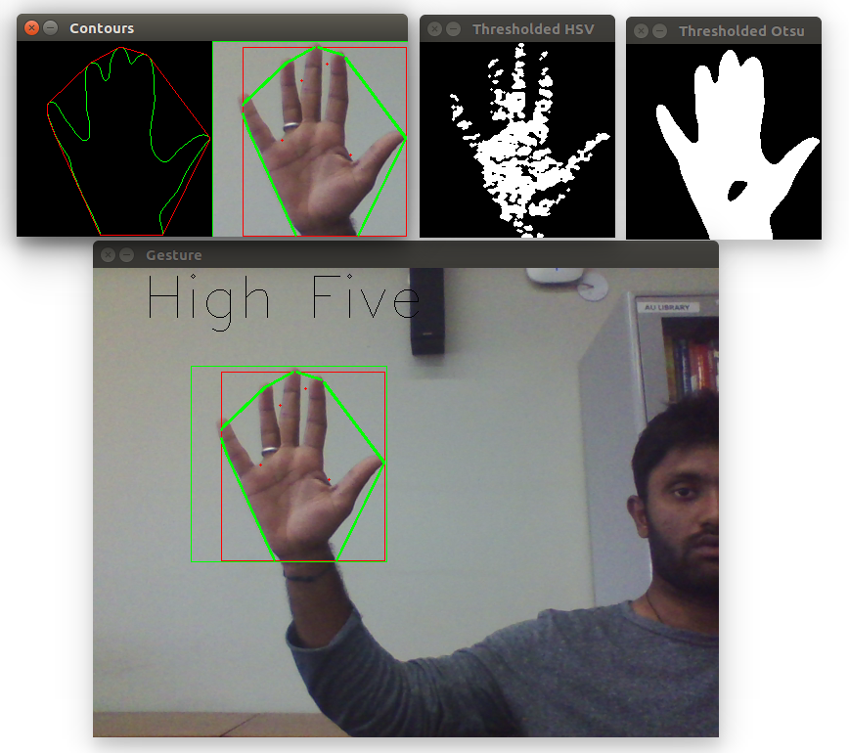
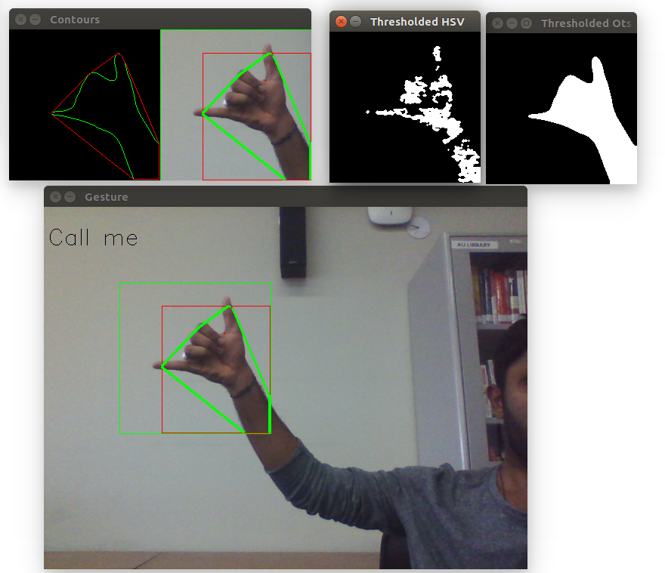
Results

Slide 7
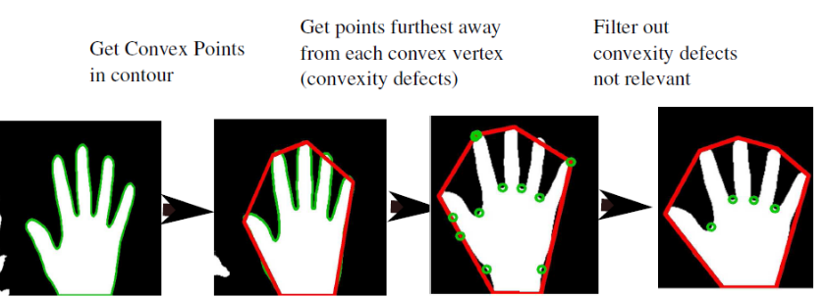
Statistical Information
Dismiss convexity defect if angle > 90°

Slide 8
Statistical Information
Box size (for gesture detection): 300 x 300
 | Ideal Conditions | Non-ideal Conditions
Accuracy | More than 85% | Between 30-50%

Slide 9
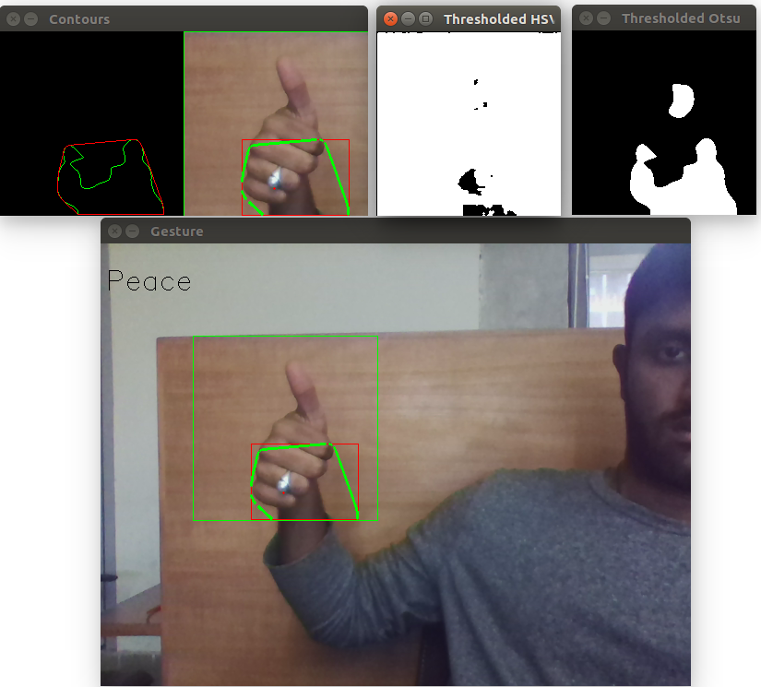
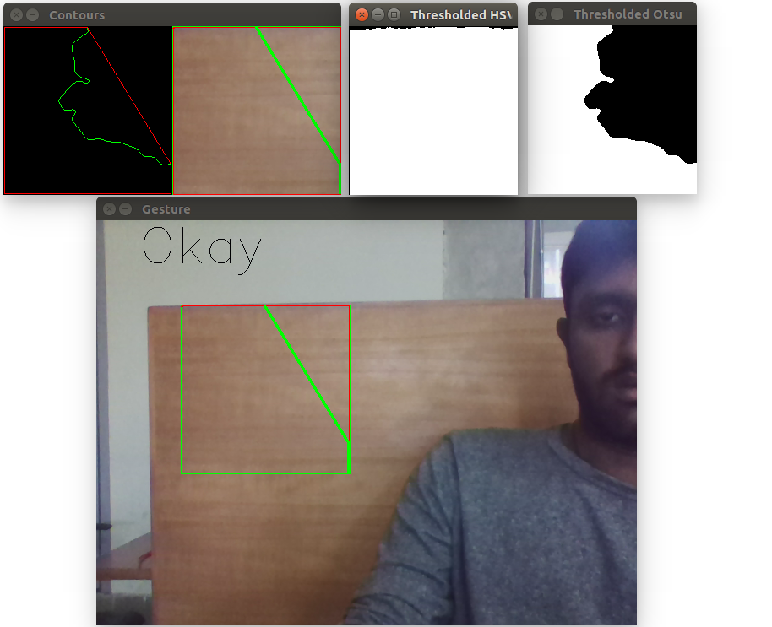
Problems

Slide 10
Observation
Skin segmentation is challenging while having a background of same colour as that of skin.
Better the Illumination, better the accuracy.
Orientation had been an issue in the initial phase of the project, but now it has been handled very efficiently by Hull Convex Method
There is a false detection of gestures in the case where there is a changing background.

Slide 11
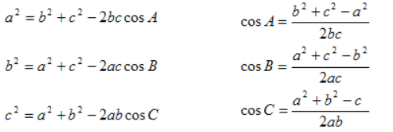
Conclusion
Hull convexity removes convexity defects and helps to form different hand contours.
Convexity defect is the deepest point of deviation on the contour
Cosine rule helps to find angle for all convexity defects and separate different gestures.

Slide 12
Future Work
To increase the robustness of the skin segmentation.
Add more gestures into the dictionary.
Reducing the limitations imposed by the usage of bounding box and automatically detecting the region of interest from the entire frame.
Define gestures using two hands

Slide 13
References
[1] Elmezain M., Al-Hamadi A., Appenrodt J., Michaelis B., "A Hidden Markov Model-based continuous gesture recognition system for hand motion trajectory,” Pattern Recognition, 2008. ICPR 2008. 19th International Conference on, vol., no., pp.1-4, 8-11 Dec. 2008.
[2] T. Starner, A. Pentland, Visual recognition of American sign language using hidden Markov model, Proceedings of the International Workshop on Automatic Face-and Gesture- Recognition, Zurich, Switzerland, June 1995,pp.189-194.
[3] Tipping, M. E., and C. M. Bishop. Probabilistic Principal Component Analysis. Journal of the Royal Statistical Society. Series B (Statistical Methodology), Vol. 61, No.3, 1999, pp. 611622.
[4] "HAND GESTURE RECOGNITION: A LITERATURE REVIEW", Rafiqul Zaman, Khanand Noor, Adnan Ibraheem, 2012, Department of Computer Science, A.M.U. Aligarh, India.
[5] "Hand-gesture recognition using computer-vision techniques", 2013, David J. Rios Soria, Satu E. Schaeffer, Sara E. Garza-Villarreal, Universidad Autonoma de Nuevo Leasn (UANL) San Nicolas de los Garza, NL, Mexico.

Slide 14
Thank You

